Slide 1
Naive Bayes Classifier

Slide 2
Conditional Probability
Probability of Event H given the Evidence E -->
P(H|E) = P(H and E) / P(E)
P(E) -> Probability of seeing the evidence is empirically observable
Same with:
P(H and E) or P(H intersection E) or P(H, E)

Slide 3
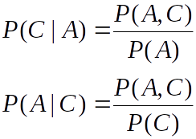

Bayes
Conditional Probability:
Reordering conditional probability equation by moving H and E around.
Bayes theorem: after we rearrange conditional probability equations to exclude P(A, C)

Slide 4
What is the intuition behind using Conditional Probability and Bayes’ Theorem for Machine Learning?
P(H|E) = P(H and E) / P(E)
In many cases, you can find out the probability of seeing the evidence E as in this medical case...
A patient goes to see a doctor. The doctor performs a test with 99% reliability--that is, 99% of people who are sick test positive and 99% of the healthy people test negative.
The doctor knows that only 1 percent of the people in the country are sick.
Now the question is: if the test comes out positive, is the probability of the patient actually being sick 99%?

Slide 5
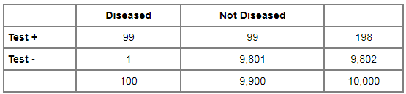
Application of Bayes Theorem

Slide 6
Application of Bayes Theorem
What we need to find: P(sick given that test is positive)
What we know from the above matrix:
P(tests positive given that person is sick): 99 / 100
P(sick) = 100 / 10000
P(tests +ve) = 198 / 10000

Slide 7
Application of Bayes Theorem
P(sick given that test is positive) =
P(tests positive given that person is sick) * P(sick) / P(tests positive)
= (99 / 100) * 100 / 198
= 0.5

Slide 8
Why Naive?
We call the algorithm Naive because we assume independence of all the evidences.
For example:
If we are to find P(banana -- GIVEN THAT IT IS -- long, sweet and yellow):
We have to assume that evidences long, sweet and yellow are independent of each other.
Something technically known as “Conditional Independence”.

Slide 9
Naïve Bayes Classifier - Fruit
 | Long | Not long | Sweet | Not sweet | Yellow | Not yellow | Total
Banana | 40 | 10 | 35 | 15 | 45 | 5 | 50
Orange | 0 | 30 | 15 | 15 | 30 | 0 | 30
Other | 10 | 10 | 15 | 5 | 5 | 15 | 20
Total | 50 | 50 | 65 | 35 | 80 | 20 | 100
A fruit is Long, Sweet and Yellow.
Is it a Banana?
Is it an Orange?
Or Is it some different fruit?

Slide 10
Naïve Bayes Classifier - Fruit
 | Long | Not long | Sweet | Not sweet | Yellow | Not yellow | Total
Banana | 40 | 10 | 35 | 15 | 45 | 5 | 50
Orange | 0 | 30 | 15 | 15 | 30 | 0 | 30
Other | 10 | 10 | 15 | 5 | 5 | 15 | 20
Total | 50 | 50 | 65 | 35 | 80 | 20 | 100
P(Banana) = 0.5 (50/100)
P(Orange) = 0.3
P(Other Fruit) = 0.2
P(Long) = 0.5
P(Sweet) = 0.65
P(Yellow) = 0.8 ……
P(Long|Banana) = 0.8
…………… we can find all probabilities

Slide 11
Naïve Bayes Classifier - Fruit
 | Long | Not long | Sweet | Not sweet | Yellow | Not yellow | Total
Banana | 40 | 10 | 35 | 15 | 45 | 5 | 50
Orange | 0 | 30 | 15 | 15 | 30 | 0 | 30
Other | 10 | 10 | 15 | 5 | 5 | 15 | 20
Total | 50 | 50 | 65 | 35 | 80 | 20 | 100
P(Banana|Long, Sweet and Yellow)
= P(Long|Banana) * P(Sweet|Banana) * P(Yellow|Banana) * P(banana)/
(P(Long) * P(Sweet) * P(Yellow))
= 0.8 * 0.7 * 0.9 * 0.5 / P(evidence) =0.252/denom
P(Orange|Long, Sweet and Yellow) = 0
P(Other Fruit|Long, Sweet and Yellow)
= P(Long|Other fruit) * P(Sweet|Other fruit) * P(Yellow|Other fruit) * P(Other Fruit)/ (P(Long) * P(Sweet) * P(Yellow)) = 0.018/denom

Slide 12
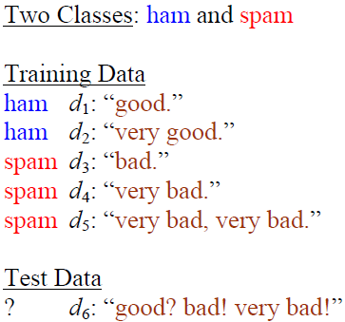
Naïve Bayes Classifier - Spam

Slide 13
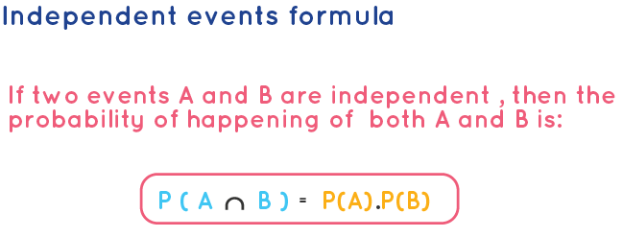
Using Bayes Theorem:
P(ham | d6) = P(d6 | ham) * P(ham) / P(d6)
What is d6: good bad very bad
P (d6 | ham) = P(good, bad, very, bad | ham)
But we have assumed conditional independence of evidence, so:
P(d6 | ham) = P(good | ham) * P(bad | ham) * P(very | ham) * P(bad | ham)

Slide 14

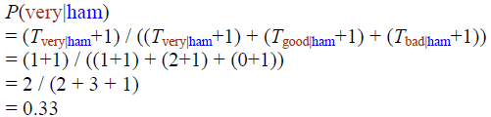
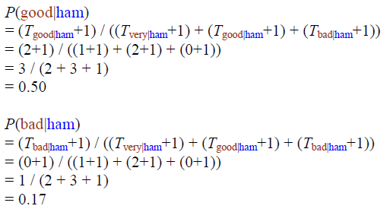
Naïve Bayes Classifier - Spam
Laplace smoothing
(+1…)

Slide 15
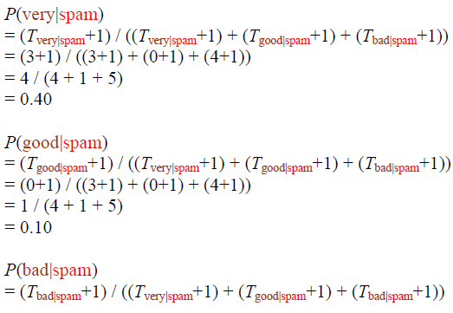

Naïve Bayes Classifier - Spam

Slide 16
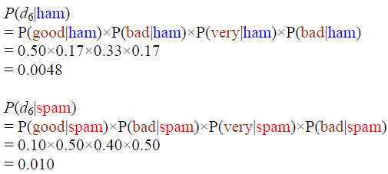
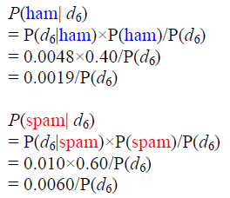
Naïve Bayes Classifier - Spam
The probabilities are calculated after Laplace smoothing.

Slide 17
Classified as Spam

